Slide 1
OPTIMIZING SECURITY IN RESOURCE CONSTRAINED SYSTEMS

Slide 2
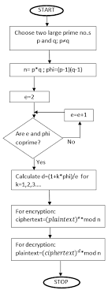

Slide 3
Choose two large primes P & Q n = P*Q
Calculate n

Slide 4
φ(n) = (P-1)*(Q-1)
Calculate φ(n)

Slide 5
1<e<φ(n) GCD(e, φ(n)) = 1 i.e. they are Co-primes
Calculate encryption key, e

Slide 6
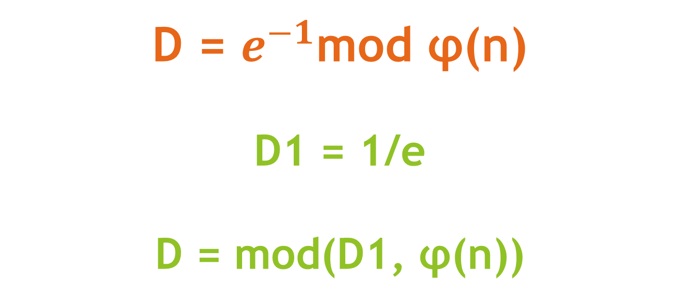
D = $e^{−1}$mod φ(n) D1 = 1/e D = mod(D1, φ(n))
Calculate decryption key, D

Slide 7

C = $M^{e}mod n$ where, M = Plaintext
Calculate Cipher Text, C

Slide 8
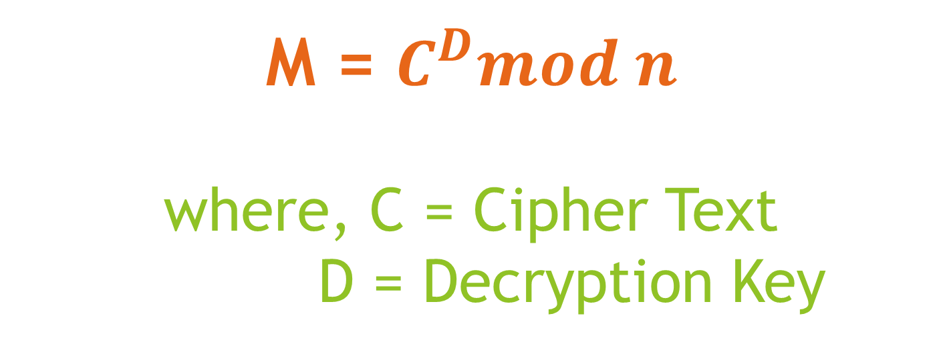
M = $C^{D}mod n$ where, C = Cipher Text D = Decryption Key
Calculate Plaintext, M

Slide 9
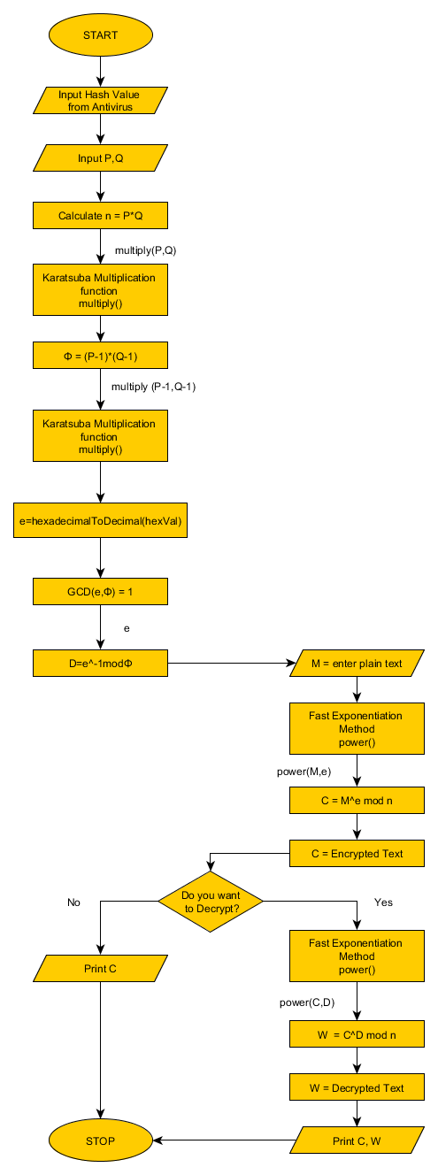
OPTIMIZED RSA ALGORITHM FLOWCHART

